Slide 1
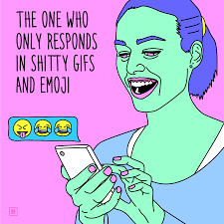
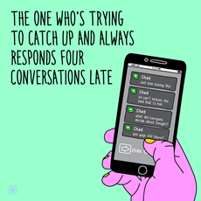
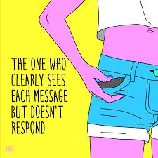
Look familiar?
Notes:
Balaji

Slide 2
CARDS
AGAINST
TELEGRAM
A CHAT-BASED
PARTY GAME FOR HORRIBLE PEOPLE
BY HORRIBLE PEOPLE
Team 03:
Sagar Patel Amir Omidi Jessica Hoban Balaji Lakshmanan Tanfe Aderemi
Notes:
Team 03

Slide 3
Motivation for Prototype
Our code
Telegram API
Chose to begin with the most difficult part...
Notes:
Jess

Slide 4
Motivation for Prototype
JSON files found online
Java Objects
GSON Conversion
… And also storing card packs
Notes:
Jess

Slide 5
Scope of Prototype
What question(s) did you determine you needed to answer?
How to store the card packs
How to communicate with Telegram
What approach did your team decide to use in answering the question(s)?
We used programming skills we already had
We found card packs online and converted them
Notes:
Tanfe

Slide 6
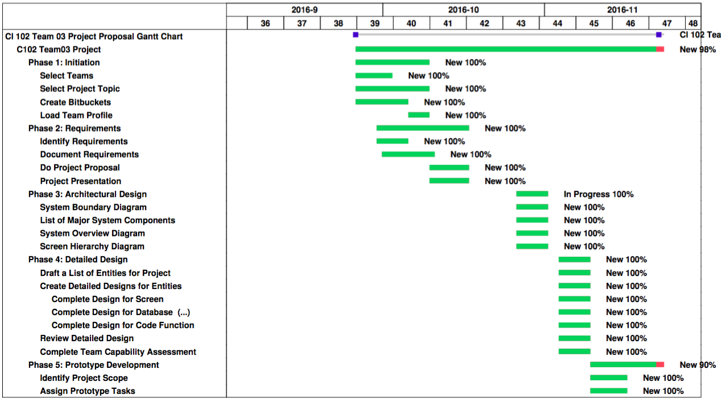
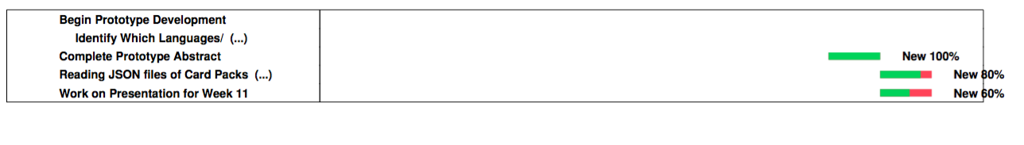
Gantt Chart
Notes:
Tanfe

Slide 7
Results
(Telegram communication code)
Notes:
Sagar

Slide 8
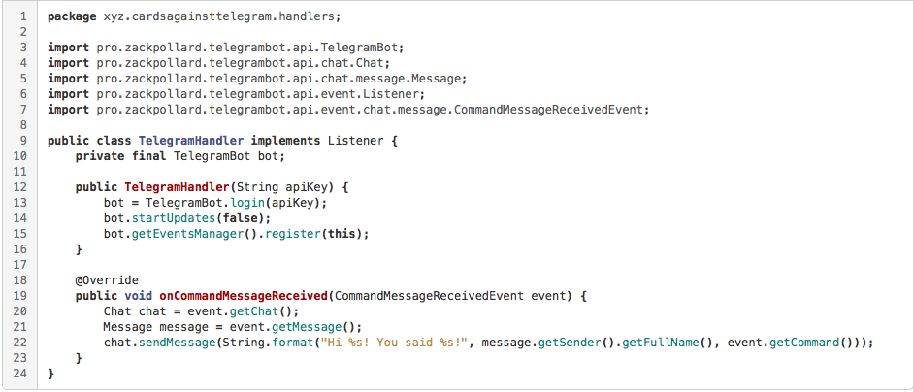
Notes:
Sagar

Slide 9
Results
(Card pack code)
Notes:
Sagar

Slide 10
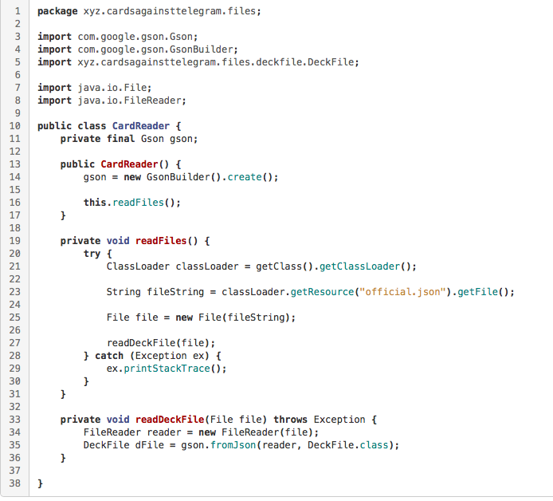
GSON: used to convert a JSON string to an equivalent Java object
Notes:
Sagar

Slide 11
Prototype Demonstration
Notes:
Jess

Slide 12
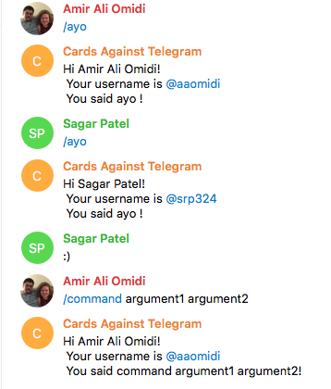
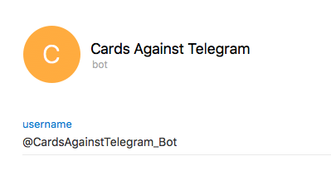
What it should look like
Notes:
Jess

Slide 13
Notes:
Balaji

Slide 14
Lessons Learned
Any new answers to past questions?
Chat-based instead of app-based
Website out of scope (unnecessary)
Any changes in your requirements and design?
Besides discarding website, no changes
Notes:
Balaji

Slide 15
Lessons Learned cont.
What did you learn about the project management process that will help you during the development phase next quarter?
To check each other’s work for completion
(Jess messed up the Gantt chart)
What did you learn about team dynamics and your team in particular that you will apply next quarter?
Teamwork makes the Dream work.
Notes:
Jess

